Slide 1
Thinking about causal inference research: Air pollution and asthma in the East Bay
CS/Stat C8R COCI Summer Bridge
Evan Muzzall, D-Lab
evan.muzzall@berkeley.edu
http://dlab.berkeley.edu/
Notes:
Causal inference research, while complex and challenging, is important to catalyze interventions that can improve the human condition.
Rather than spurious association, causal relationships suggest that patterns in data cause patterns in other data.
The goal of this example is to outline some challenges when thinking about causal research.
Maps are used to show how proper visualizations can illuminate patterns of different kinds.
For this example we will focus on maps of Alameda County.
Alameda County historically has high asthma hospital admittance rates.
Alameda County historically also has high air pollution rates.
In 2009-2014, laws were passed requiring trucks to install emissions filters and cleaner burning engines.
Research shows strong relationships between asthma and air pollution.
Research Question:
Will reduced emissions from idling trucks around Port of Oakland cause reduced asthma hospital admission rates?
That is, will asthma hospital admittances decrease after treatment was applied (i.e., new emissions laws) compared to before?
*NOTE: all images are hyperlinked to their original sources

Slide 2
AQI
O3
Particulate
CO
SO2
NO2
Notes:
Living downwind of air pollution is a significant health risk. Air pollution is linked to a number of cardiovascular and circulatory diseases.
Air Quality Index (AQ) is a measure of 5 pollutants, 0-500 scale – who is at risk?
ground-level ozone (good versus bad) and particle pollution
carbon monoxide, sulfur dioxide, nitrogen dioxide.
Ozone and particulate matter pollution are particularly harmful to humans and cause a variety of cardiovascular and circulatory diseases.

Slide 3
Notes:
https://airnow.gov/index.cfm?action=aqibasics.particle
Tiny particle pollution is the toxic variety produced by fuel combustion.
Scales of human hair (60 um) and beach sand (90 um)
PM10 are larger, generally less harmful air particles between 2.5-10.0 um
PM2.5 – need SEM to view. All types of combustion: motors/engines, wood burning/fires, industry, <2.5 um

Slide 4
Asthma
What is asthma?
Where does asthma occur most frequently? What are the characteristics of these populations? Why?
David Renna’s project:: http://drenna6.blogspot.com/2010_09_01_archive.html
See the maps here:
Healthy Alameda County’s Asthma Emergency Department Visit Rate
Check out California Breathing’s asthma data:
http://www.californiabreathing.org/asthma-data/county-asthma-profiles/alameda-county-asthma-profile
Notes:
See David Renna’s excellent work:
http://drenna6.blogspot.com/2010_09_01_archive.html
What do county-wide asthma rates look like?
View California Breathing’s asthma data:
http://www.californiabreathing.org/asthma-data/county-asthma-profiles/alameda-county-asthma-profile
Check out Healthy Alameda County’s Asthma Emergency Department Visit Rates:
http://www.healthyalamedacounty.org/index.php?module=indicators&controller=index&action=view&indicatorId=2203&localeId=238
Since legislation was passed requiring emissions filters and cleaner burning engines, asthma hospitalization rates have trended downward.
The red up arrow = current value is higher than comparison
Blue equal = similar to prior value
Green down arrow = suggests non-significant reduction trend
Data source: OSHPD (Office of Statewide Health Planning and Development)

Slide 5
Notes:
Temporal perspectives of hospital admissions.
http://www.berkeleycitizen.org/Air%20Quality/asthma.htm
1) Asthma hospital admissions 1994-1996
https://www.cdc.gov/pcd/issues/2006/jul/05_0187.htm
2) Asthma emergency room admissions 2001
3) Asthma hospital admissions 1998-2003
“Figure 3. Raster surface for rates of asthma-related emergency department visits among Kaiser Permanente and Medi-Cal fee-for-service enrollees younger than 18 years in 2001, Alameda County, California. Subsets of the total areas having statistically significantly elevated rates are indicated with arrows. (A, neighborhood of North Oakland; B, neighborhood of West Oakland; C, neighborhood of San Antonio; D, neighborhood of East Oakland; E, western portion of city of Castro Valley; F, neighborhood of South Hayward; G, southwestern portion of city of Pleasanton; H, southeastern portion of city of Livermore; I, southwestern portion of city of Fremont.)”
citation:US DHHS – ASPE – neighborhoods and helath:
https://aspe.hhs.gov/report/neighborhoods-and-health-building-evidence-local-policy/section-8-context-analysis

Slide 6
Notes:
Temporal perspectives of hospital admissions
http://www.berkeleycitizen.org/Air%20Quality/asthma.htm
1) Asthma hospital admissions 1994-1996
https://www.cdc.gov/pcd/issues/2006/jul/05_0187.htm
2) Asthma emergency room admissions 2001
“Figure 3. Raster surface for rates of asthma-related emergency department visits among Kaiser Permanente and Medi-Cal fee-for-service enrollees younger than 18 years in 2001, Alameda County, California. Subsets of the total areas having statistically significantly elevated rates are indicated with arrows. (A, neighborhood of North Oakland; B, neighborhood of West Oakland; C, neighborhood of San Antonio; D, neighborhood of East Oakland; E, western portion of city of Castro Valley; F, neighborhood of South Hayward; G, southwestern portion of city of Pleasanton; H, southeastern portion of city of Livermore; I, southwestern portion of city of Fremont.) ”
3) Asthma hospital admissions 1998-2003
https://www.cdc.gov/pcd/issues/2006/jul/05_0187.htm

Slide 7
Notes:
Temporal perspectives of hospital admissions
http://www.berkeleycitizen.org/Air%20Quality/asthma.htm
1) Asthma hospital admissions 1994-1996
https://www.cdc.gov/pcd/issues/2006/jul/05_0187.htm
2) Asthma emergency room admissions 2001
3) Asthma hospital admissions 1998-2003
https://www.cdc.gov/pcd/issues/2006/jul/05_0187.htm
Figure 3. Raster surface for rates of asthma-related emergency department visits among Kaiser Permanente and Medi-Cal fee-for-service enrollees younger than 18 years in 2001, Alameda County, California. Subsets of the total areas having statistically significantly elevated rates are indicated with arrows. (A, neighborhood of North Oakland; B, neighborhood of West Oakland; C, neighborhood of San Antonio; D, neighborhood of East Oakland; E, western portion of city of Castro Valley; F, neighborhood of South Hayward; G, southwestern portion of city of Pleasanton; H, southeastern portion of city of Livermore; I, southwestern portion of city of Fremont.)
citation:US DHHS – ASPE – neighborhoods and helath:
https://aspe.hhs.gov/report/neighborhoods-and-health-building-evidence-local-policy/section-8-context-analysis

Slide 8
Air pollution
Asthma
Poverty
Notes:
US DHHS – ASPE – neighborhoods and health:
https://aspe.hhs.gov/report/neighborhoods-and-health-building-evidence-local-policy/section-8-context-analysis
Poverty rates 1990
Unfortunately, these same neighborhoods have been historically impoverished.

Slide 9
Notes:
Persistent poverty
http://ac-hcsa.maps.arcgis.com/home/item.html?id=c7eac040d44e47939d94bbad80ab630e
1970s, 1980s, 1990s, 2000s, 2010s
Santa Rita Jail and UC Berkeley are excluded.

Slide 10
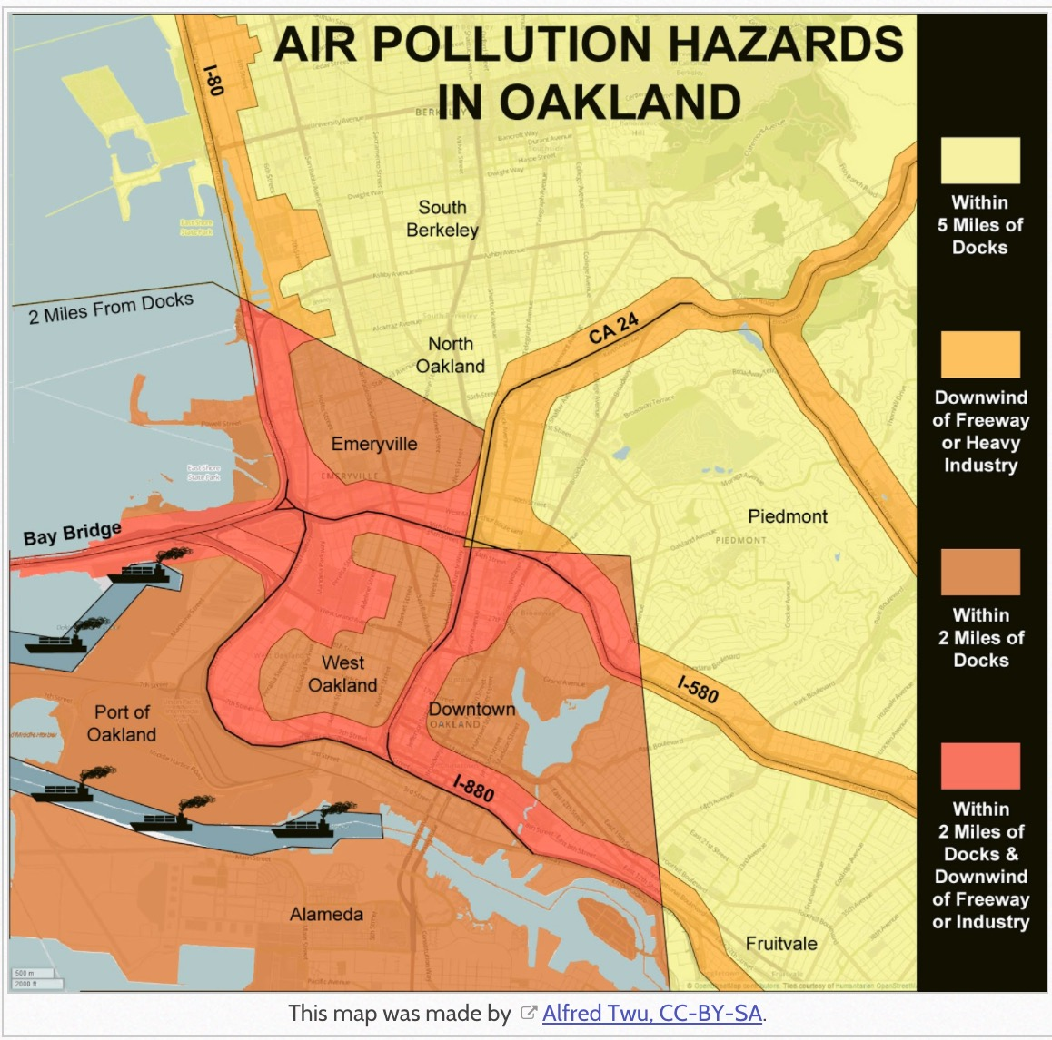
Notes:
- How well do the persistent poverty and air pollution hazards in Oakland maps line up? Coincidence?

Slide 11
Return to the research question: will reduced truck idling cause less asthma?
What about other sources of pollution?
What else do we know?

Slide 12
Air pollution
Asthma
Poverty
Unemployment
Notes:
High unemployment in these same areas further compounds the issue.
https://archives.hud.gov/reports/plan/ca/alamedca.html

Slide 13
1. Unemployment
Air pollution
Asthma
Poverty
Unemployment
Income
Notes:
High unemployment means low median household incomes…
http://andrewgaidus.com/Dot_Density_County_Maps/

Slide 14
Air pollution
Asthma
Poverty
Unemployment
Income
Life expectancy
Notes:
… which potentially means lower life expectancy
Check out research at VCU:
http://www.news.vcu.edu/article/VCU_Researchers_Study_Health_Disparities_in_Three_Communities

Slide 15
Air pollution
Asthma
Poverty
Unemployment
Life expectancy
Tuberculosis
Notes:
…especially when other illnesses such as tuberculosis are incorporated…
http://www.acphd.org/data-reports/reports-by-topic/tuberculosis-(tb).aspx
View various topics here: http://www.acphd.org/data-reports/reports-by-topic.aspx

Slide 16
Air pollution
Asthma
Poverty
Unemployment
Life expectancy
Mortality
Tuberculosis (cont.)
Notes:
http://www.acphd.org/data-reports/reports-by-topic/tuberculosis-(tb).aspx
Are rates of TB increasing?

Slide 17
Air pollution
Asthma
Poverty
Unemployment
Life expectancy
Tuberculosis
Infant mortality
Notes:
… infant mortality also.
IPODR mortality rates:
http://ipodr.org/001/vs/mortality.html

Slide 18
Air pollution
Asthma
Poverty
Unemployment
Life expectancy
Mortality
Tuberculosis
Race
Notes:
https://en.wikipedia.org/wiki/Oakland,_California#/media/File:Race_and_ethnicity_2010-_San_Francisco,_Oakland,_Berkeley_(5560477152).png

Slide 19
Air pollution
Asthma
Poverty
Unemployment
Life expectancy
Mortality
Tuberculosis
Race
Insurance coverage
https://www.cdc.gov/pcd/issues/2006/jul/05_0186.htm
Notes:
Roberts et al. 2006b. Progress in Pediatric Asthma Surveillance I: The Application of Health Care Use Data in Alameda County, California
https://www.ncbi.nlm.nih.gov/pmc/articles/PMC1637799/
- OSHPD Medi-Cal is children age 0-14; all others are 0-17

Slide 20
Gentrification stages
Air pollution
Asthma
Poverty
Unemployment
Life expectancy
Mortality
Tuberculosis
Race
Insurance coverage
etc…
Notes:
- http://oaklandlocal.com/2014/04/study-finds-gentrification-in-oakland-hurts-public-health/

Slide 21
What are some challenges of approaching causal inference research?
Identifying data sources
Temporal and spatial congruity
Identifying relevant features
Asking relevant research questions
Statistical modeling
Quantifying uncertainty
Return to the research question: how might you assess whether or not the legislation requiring less emissions of idling trucks will cause reduced rates of asthma hospital admissions given the other variables?

